Slide 1
_{ACT™} _{Model} _{Learning Cohort}
In partnership with Colorado Access Foundation
_{February – May 2025}
_{WORKBOOK}

Slide 2
Our Secret to Maximize Your Impact
We know how complex data can be.
Our 3-step process, ACT™, powers everything we do, teaching
how to not only make sense of data but to also do more with it.
ALIGN
CAPTURE
TRANSFORM
Develop your impact strategy and identify learning questions
Ensure you’re asking the right questions, create and pilot data collection tools
Use data to build a culture of learning, drive greater impact, create plans for implementation
© 2022 RESULTSLAB

Slide 3
_{Table of Contents}
How to Use this Workbook:
The ACT™ Model workbook is divided into three modules: Align, Capture, Transform. We have included graphic organizers for each step and templates for you to build out your own developments.
_{ALIGN}
SECTION 1: CREATE AN IMPACT STRATEGY ​​
SECTION 2: IDEATE LEARNING QUESTIONS
SECTION 3: REFLECTION & TAKEAWAYS
_{CAPTURE}
SECTION 1: BUILD A STRONG PLAN FOR MEASUREMENT
SECTION 3: CREATE OR REFINE DATA COLLECTION TOOLS
SECTION 3: DATA SENSE MAKING
_{TRANSFORM}
SECTION 1: DATA COMMUNICATION & TOOLS
SECTION 2: IMPLEMENTATION PLAN
_{APPENDIX}
© 2022 RESULTSLAB

Slide 4
ALIGN PHASE TO DO LIST
TASKS
What | Who | When
Create Impact Strategy
Draft Initial Learning Questions and review with your team

Slide 5
_{Align}
SECTION 1: DESIGN AN IMPACT STRATEGY
Learning Objectives
You’ll be able to:
Identify answers to three questions essential to strategic planning: With whom/in what are we trying to make a change?, What do we do to make change?, What changes are we creating? Use these answers to create your Impact Strategy Understand the value of identifying organizational goals and outcomes before developing a measurement plan.

Slide 6
With whom are you trying to make a change? | What do you do to make change? | What changes are you creating? |  | To what end?
People We Engage | Core Activities or Services | Short-Term Outcomes | Long-Term Outcomes | End Goal (Impact)
Start Here!
Outcome(s) = The thing(s) that will be different as a result of your efforts
What will be different? Who will it be different for?
Common Types of Outcomes
Change in skills, knowledge, practice (Short Term)
Change in behavior, attitudes, beliefs (Mid Term/Long Term)
Change in condition(s) (Short Term/Mid Term/Long Term)

Slide 7
_{Align}
SECTION 2: CREATING LEARNING QUESTIONS
Learning Objectives
You’ll be able to:
Identify key learning questions around your programming

Slide 8
Cheat Sheet: Learning Questions
What is a learning question?
A learning question is simply a question you have about your program, initiative, or community that you can answer through data.
While the concept of a learning question overlaps with terms such as research or evaluation question, we lead with learning because the exploration of the data should be in the greater spirit of learning and action.
What makes a strong learning question?
A strong learning question has certain qualities that make it more likely to be successfully answered with data and to be used for action. ​
​
Review each question, and check if your learning question is:
Relevant: Does your question align with your program goals? Is it timely given your current context?​
Useful: Will your question help inform strategic decisions that will be used by stakeholders to make decisions or improvements? Are others asking for clarity on this question?​
Feasible: Can you realistically answer this question with the data, timeline, and/or resources you have available right now?
Focused: Is the question specific on the who, what, and where?
What are some commonly used implementation and impact learning questions?
Is the program being delivered in the way it was intended? (Implementation)
Do those involved in the program experience positive changes after participation? (impact)
How does the program vary across locations? (implementation)
Do participants experience changes in knowledge and skills more so than those who do not participate? (impact)
What participants or things (e.g. program sites) seem to have more positive outcomes? (implementation)

Slide 9
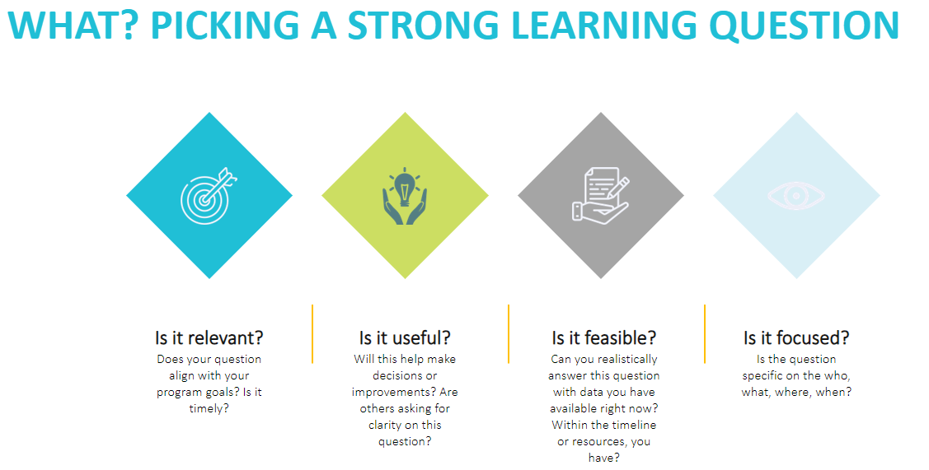
Learning Questions
Consider starting with an Evergreen Learning question and then iterating to make it more specific to your organizational or program interests! A specific learning question helps to develop the specific indicators it takes to answer it.
Ask these questions when selecting a learning question. If you can’t answer a question, or see that it is weak in one area, deepen your learning question to include this consideration.

Slide 10
Get Curious About Your Programs
Step 1: Brainstorm!
Think about one of your programs or services…
What are you curious to learn more about?
Why?
How might you use this information?
Identify: Are your curiosities about how you do what you do? Or What happens as a result of what you do?
Step 2: Translate curiosities into learning questions & think critically about each one
Learning Questions What do you want to know about your program, informed by your Impact Strategy and Program Model? | Relevant Does this learning question align with your organization outcomes? Is it timely given our current context? | Useful Will your question help inform strategic decisions or program and initiative improvements? How? | Feasible Can you realistically answer this question with the resources and timeline you have available right now?
After you have reviewed all LQs, prioritize each Learning Question: High (1), Medium (2), Low (3) This will help to inform the development of a measurement plan.

Slide 11
Moment of Reflection
A-Ha Moments & Key Learnings
Think about the discussions and work completed during this phase….
What were some of your A-Ha moments when you identified something new or important? Or saw something differently?
What assumptions have you challenged about your evaluation or data practices?
What gaps have you identified?
What knowledge or skills have you strengthened? How has this influenced your evaluation or data practices?
What have you learned that you think might be useful to share with your organization?
Brainstorm 3- 5 Learnings you might take back to your organization.
A-Ha Moment | Key Learning | Why it might be useful to share? What can other organizations gain from your insights?

Slide 12
CAPTURE PHASE TO DO LIST
TASKS
What | Who | When
Create Measurement Strategy
Refine Learning Questions + Generate Possible Indicators
Draft out what information you have for your Measurement Plan/Evaluation Framework
Select a tool to pilot and complete Data Collection Tool Action Plan
Finalize your Tool design
Develop a Data Collection Protocol
Complete Data Analysis Protocol
Collect data using your new tool
Review and Finalize your Measurement Plan

Slide 13
_{Capture}
SECTION 1: IDENTIFY MEASUREMENT GOALS & OBJECTIVES
Learning Goals & Objectives
You’ll be able to:
Identify Measurement Goals + Objectives + and finalize your Learning questions. This will be your Measurement Strategy.

Slide 14
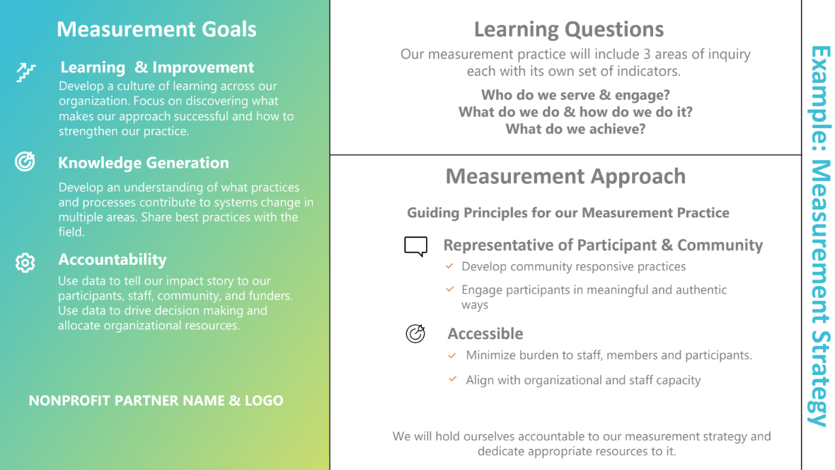
Create a Measurement Strategy
Use the Worksheets in this section to develop the 3 elements of your Measurement Strategy
Once complete, import the information from the worksheets into this framework.

Slide 15
Create a Measurement Strategy
Use the Worksheets in this section to develop the 3 elements of your Measurement Strategy
Once complete, import the information from the worksheets into this framework.
Measurement Goals (Reorder) | Learning Agenda
 | Learning Questions | Possible Indicators
Proving Impact: Primary Goal. This looks like … Learning and Improvement: Secondary Goal. This looks like … Knowledge Generation: Secondary Goal. This looks like … Accountability: Tertiary Goal. This looks like…
 | Values

Slide 16
Measurement Goals + Principles/Values
Measurement Goals
Measurement Goals | High Priority? | What does this look like for us?
Learning + Improvement
Proving Impact
Knowledge Generation
Accountability
Other
Measurement Values
Measurement Principles/Values | High Priority | Medium Priority | Low Priority
Accessible
Accurate/Rigorous
Cost Effective
Integrated (to operations, processes, and across programs)
Interactive/Fun
Low Burden
Relevant
Representative (of community/participant voice) Equitable
Other

Slide 17
Learning Question and Indicators
Learning Questions | Possible Indicators

Slide 18
_{Capture}
SECTION 2: BUILD A STRONG PLAN FOR MEASUREMENT
Learning Objectives
You’ll be able to:
Identify common elements of a comprehensive measurement plan.

Slide 19
Starting your Measurement Plan
Learning Question:
Outcome​ Thing that changes because of the activity​ | Evidence​ Information you will collect to demonstrate change​ | Method for tracking or gathering information to count as evidence​ | Details about how, when and from whom organization will collect data systematically​ | Details for organizing, reviewing and identifying results​
 | Indicators | Data Collection Tools/Instruments | Data Collection Implementation | Data Analysis

Slide 20
_{Capture}
SECTION 3: CREATE OR REFINE DATA COLLECTION TOOLS
Learning Objectives
You’ll be able to:
Identify existing tools currently being used to collect data relevant to new measurement plan. Explore a variety of data collection methods. Choose to refine an existing tool or create new a new tool.

Slide 21
Consider existing tools and explore other data collection methods.
Which methods are most interesting or in alignment with Measurement Strategy?
This tool needs to… | Methods to Consider
Capture the relationships between people, places, and spaces | Social Listening with Social Media | Surveys | Document And Product Review
Go deep with a smaller number of people | Focus Groups | Interviews | Observation | Online Journals
Capture information in a way that is participant-centered | Photovoice | Online Journals | Voice Memos | Artistic Expression | Document And Product Review
Capture system-level information | Records | Mapping
Collect data in A short amount of time | Social Listening with Social Media | Pulse Surveys
Capture the relationships between people, places, and spaces | Mapping | Photovoice
Capture changes in skills, knowledge, or practices in a standardized way | Assessments And Tests | Surveys, Questionnaires, Polls (That Have Been Developed And Used Across Organizations)
HOT TIP: :Go back to your Measurement Strategy Values. Which of these tools best align with your values around data and measurement?
Discussion Notes:

Slide 22
Data Collection: Action Planning for Implementation
What |  | Who | When
What? | Task Details | Who is responsible for this task? | Dates
Creating a plan for refining and developing a tool |  | (Coach)
Creating and reviewing protocols |  | (Coach)
Identifying & recruiting a sample |  | Ex. NPP Team
Logistics of implementation (who, when, where, how)

Slide 23
_{Capture}
SECTION 4: PILOT TOOLS & PRACTICE DATA ANALYSIS
Learning Objectives
You’ll be able to:
Develop clear protocols to implement one data collection tool relevant to measurement plan. Pilot a tool with a small sample. Use a systematic approach to analyze data.

Slide 24
Data Collection Protocols
Selected Tool:
Implementation Aspect | Notes
What will be implemented?
When will it be implemented?
Who will implement it?
Do you need to create an informed consent form?
Who will this collect data from?
How will this be implemented? Provide clear instructions for staff responsible for using the tool here.
How will you securely store the data?
When and how will you dispose of the data?

Slide 25
Cheat Sheet: Data Tool Cover Page
*This cover sheet can be created and stored for each of your data collection methods (and tools that fall into each methodological category). Clearly documenting details about your collection can increase efficiency and decrease confusion.
Method and Tool
A method describes a way of gathering information like a focus group or survey. Tool describes the specific way of collecting your data, like the specific survey or interview guide.
Storage and Administration
Describe how the method you have selected works and/or any step-by-step guidance for the specific tool.
Note the system and/or storage location for the tool.
Source
Who or where will your data come from?
Collection Timeline and Responsibility
Timeframe for data collection and/or frequency of data collection
People, programs, locations, or other units that will collect the data
Analysis Timeline and Responsibility
Timeframe for analysis
The person, departments, or other units that will analyze the data
Notes

Slide 26
Data Analysis Protocols
Selected Tool:
Implementation Aspect | Notes
What will be analyzed?
When will it be analyzed?
Who will analyze it?
What tools will you use?
How will this be analyzed? Provide clear instructions for staff responsible for using the tool here.
[Insert tool screen shot here]

Slide 27
Qualitative Data Analysis Cheat Sheet
1. Data Preparation: Dive In & Clean Up
Review & Familiarize: Read through all your data to get a sense of the whole.
Organize & Structure: Put your data in a format that works for coding (spreadsheets, software).
Clean & Refine: Fix any typos, inconsistencies, or missing information for accurate analysis.
2. Coding & Theme Development:
Break down your data: Divide text into meaningful units (sentences, paragraphs) and assign initial codes that capture key concepts.
Refine & identify themes: Review your codes, looking for patterns and connections. Group related codes, refine them for consistency, and develop themes that represent these groupings, ensuring they are distinct, supported by data, and relevant to your research question. Review your codes in relation to other elements of your data (Demographics, services used, etc).
3. Develop a Narrative: Craft a story that integrates your themes and helps you understand the experiences of your participants.
Your Learning Question:
Theme Name:
Theme Description:
Sample Excerpts from Data:

Slide 28
Practice: Collating & Revising Codes Tool
Tell the Story
Code 1
Code 2
Snip
Snip
Snip
Snip
Snip
Snip
Code 3
Snip
Snip
Snip
HOT TIP: Remove codes that don’t have sufficient data.
Combine codes that are alike or separate codes out if there are meaningful differences in the data.
Notes:
Remove codes that lack data
Revise codes that need to be more specific

Slide 29
Qualitative Data Training: Codebook Tools
Learning Questions
Datasets to be Used | Data Type (Quant, Qual, Both) | Inclusions | Exclusions
Qualitative Approach
Code What are you calling this code? | Expectations What do you expect to see related to this code? | Reality What did you see related to this code? | Count How many times did this code come up? | Themes Overarching theme that encompasses your findings from this code.

Slide 30
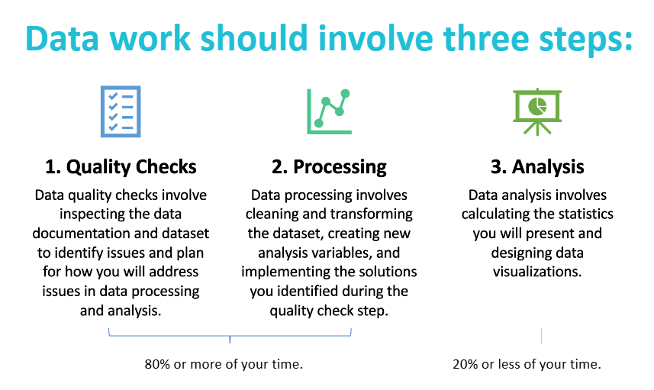
Quantitative Data Analysis Cheat Sheet
The hardest part of analysis is preparing data for accurate analysis and choosing the right statistics to tell your story.
Quality Checks: Check for Completeness, Consistency, and Cleanliness
Processing:
1) Implement data quality check solutions: address potential errors and missing data.
2) Prepare data for analysis: Create an analysis dataset and create new analysis variables where needed, like binary and categorical variables for example.
3) Document, Document, Document: Take notes of all of the decisions that you made.
Analysis: There are 3 types of descriptive statistics: Frequency (and proportion), measures of central tendency (mean, median, and mode), and measures of variability (range, IQR, standard deviation, and variance).
Notes:
Resource: See Kupenda Data Analysis Playbooks in ResultsLab SharePoint

Slide 31
Moment of Reflection
A-Ha Moments & Key Learnings
Think about the discussions and work completed during this phase….
What were some of your A-Ha moments when you identified something new or important? Or saw something differently?
What assumptions have you challenged about your evaluation or data practices?
What gaps have you identified?
What knowledge or skills have you strengthened? How has this influenced your evaluation or data practices?
What have you learned that you think might be useful to share with your organization?
Brainstorm 3- 5 Learnings you might take back to your organization.
A-Ha Moment | Key Learning | Why it might be useful to share? What can other organizations gain from your insights?

Slide 32
TRANSFORM PHASE TO DO LIST
TASKS
What | Who | When
Create Data Use Strategy
Analyze Program Data
Create Data Portfolio
Host Data Action Session
Create Data Action Plan
Create Playbook Slide
Attend final ACT Cohort Session

Slide 33
_{Transform}
_{SECTION 1: DATA USE STRATEGY}
Learning Objectives
You’ll be able to:
Identify answers to four questions essential to data use planning: Who needs the data? What would they want to know? What is the ideal communication vehicle? When would we share this with them? Understand the value of identifying organizational goals in communicating data, before using and sharing data.

Slide 34
Creating a Data Use Strategy
DATA USE STRATEGY
Who Who needs to use this data? | What What would they want to know? (tie to learning questions) | How What is the ideal communication vehicle? | When When should we share this with them?

Slide 35
_{Transform}
SECTION 2: EMERGENT LEARNING & DATA ACTION PLANNING
Learning Objectives
You’ll be able to:
Create a data portfolio for use during a Data Action Session. Leverage emergent learning and impact matrix process for developing a data action plan.

Slide 36
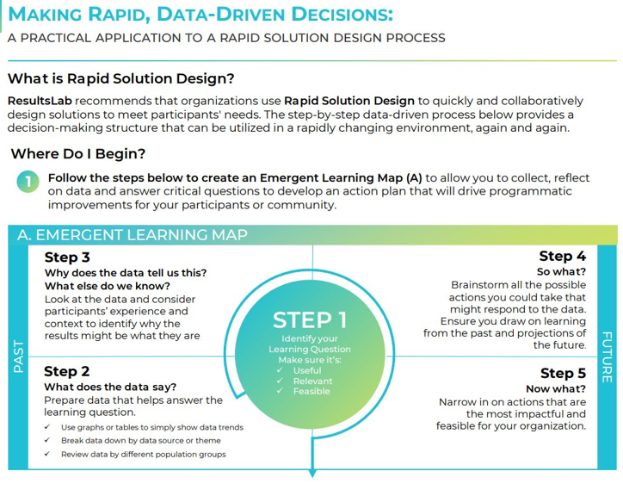
Data Action Rapid Data Driven Decision - Exploration
Send data to teams in advance
Include organizational leadership and frontline staff (as appropriate)
Consider inviting partners that serve a similar client-base; no one organization can meet all emerging community needs
End your session with concrete action items of what will be done, by whom, and when
Connecting virtually?
Share your screen and populate the Emergent Learning Map and Impact Matrix in real-time
Use the sticky notes below to practice the emergent learning process!

Slide 37
Data Action Rapid Data Driven Decision - Exploration
Send data to teams in advance
Include organizational leadership and frontline staff (as appropriate)
Consider inviting partners that serve a similar client-base; no one organization can meet all emerging community needs
End your session with concrete action items of what will be done, by whom, and when
Connecting virtually?
Share your screen and populate the Emergent Learning Map and Impact Matrix in real-time
Use the sticky notes below to practice the emergent learning process!
A. EMERGENT LEARNING MAP
Step 3
Step 4
STEP 1
LEARNING QUESTION
PAST
Step 2
FUTURE
Step 5
B. IMPACT MATRIX
HIGH
IMPACT
LOW
FEASIBILITY
LOW
HIGH

Slide 38
Creating a Data Action Plan
DATA ACTION PLAN
Note: The activities outlined below pertain to the Data Action Session held on xx/xx/xxxx.
What |  | Who | When
What can we take forward? Describe the specific task. | Type of Action & Tool: Data, Programming, Communication | Who will be responsible for this? | When should it be done?
Address Data Gaps All staff data entry training to address data completion issues Compare data completeness from the pilot vs after all staff training to ensure issue has been addressed | Type of Action: Data & Programming Tool: Training Slide Deck | Data Coordinator | By Friday April 5th, 2024

Slide 39
Moment of Reflection
A-Ha Moments & Key Learnings
Think about the discussions and work completed during this phase….
What were some of your A-Ha moments when you identified something new or important? Or saw something differently?
What assumptions have you challenged about your evaluation or data practices?
What gaps have you identified?
What knowledge or skills have you strengthened? How has this influenced your evaluation or data practices?
What have you learned that you think might be useful to share with your organization?
Brainstorm 3- 5 Learnings you might take back to your organization.
A-Ha Moment | Key Learning | Why it might be useful to share? What can other organizations gain from your insights?

